Slide 1
Enthuse Workshop
Intro to Data Science

Slide 2
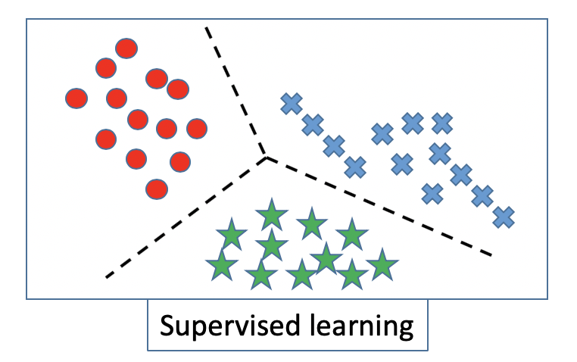
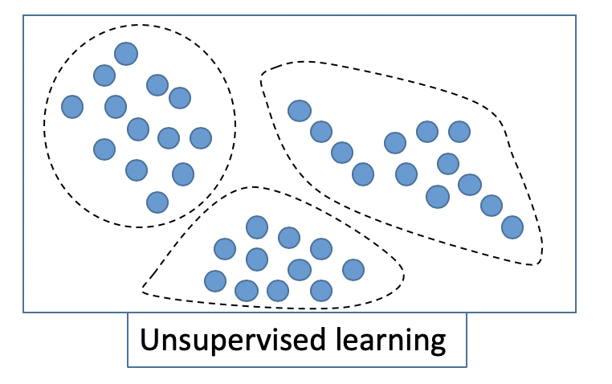
Outline
Supervised Learning
Linear Regression
Classification
Unsupervised Learning
K-means Clustering

Slide 3

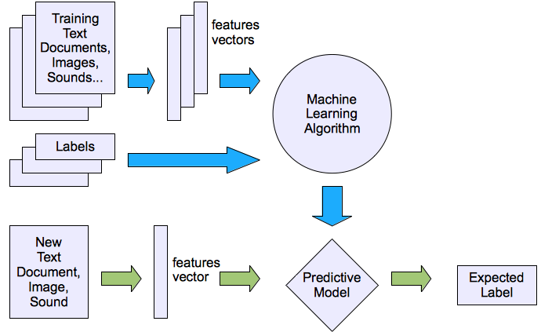
Supervised Learning Process

Slide 4
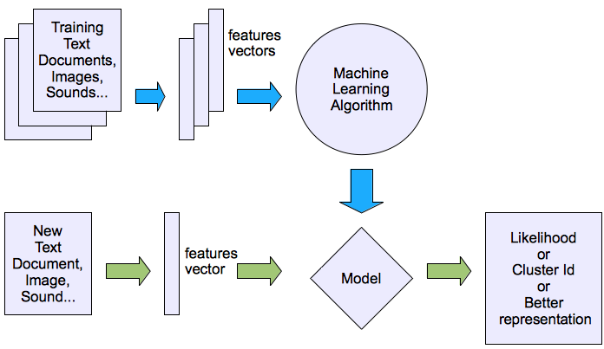
Unsupervised Learning Process

Slide 5
Part 1. Supervised Learning: Linear Regression

Slide 6
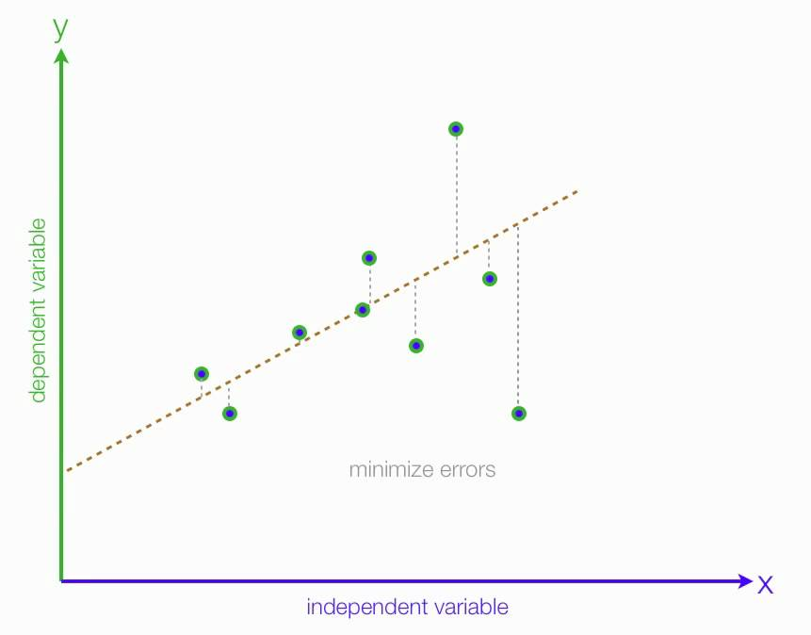
Linear regression
y = ax + b
Notes:
Linear regression performs the task to predict a dependent variable value (y) based on a given independent variable (x). So, this regression technique finds out a linear relationship between x (input) and y(output). Hence, the name is Linear Regression.

Slide 7
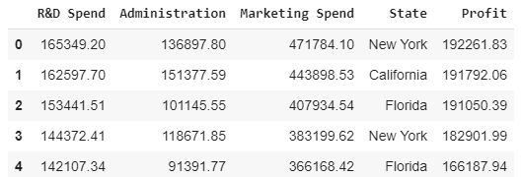
Linear regression: preparing data
the 4th column is text.
we can’t have text in our data if we’re going to run any kind of model on it.
we need to make this data ready for the model: convert it to numbers

Slide 8
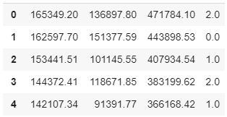
preparing data: label encoder
Each distinct name should be replaced by a number

Slide 9
preparing data: label encoder
Code:
from sklearn.preprocessing import LabelEncoder, OneHotEncoder
labelencoder = LabelEncoder()
X[:, 3] = labelencoder.fit_transform(X[:, 3])

Slide 10
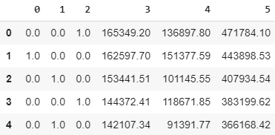
Problem with our encoding
The data is categorical and does not have any relation between different categories
However, our encoding implies a relation: 0 < 1 < 2.
To overcome this problem, we use One Hot Encoder:
Notes:
Onehot encoding: create new attributes according to the number of classes present in the categorical attribute i.e if there are n number of categories in categorical attribute, n new attributes will be created. These attributes created are called Dummy Variables

Slide 11
One-hot encoding
Code:
onehotencoder = OneHotEncoder(categorical_features = [3])
X = onehotencoder.fit_transform(X).toarray()

Slide 12
Predicting the profit using linear regression
We need to split the dataset into the training set and test set:
from sklearn.model_selection import train_test_split
X_train, X_test, y_train, y_test = train_test_split(X, y, test_size = 0.2, random_state = 0)

Slide 13
Predicting the profit using linear regression
And then fit a regression model:
from sklearn.linear_model import LinearRegression
regressor = LinearRegression()
regressor.fit(X_train, y_train)

Slide 14
Predicting the profit using linear regression
Test the model:
y_pred = regressor.predict(X_test)

Slide 15
Part 2. Unsupervised Learning: K-means Clustering

Slide 16
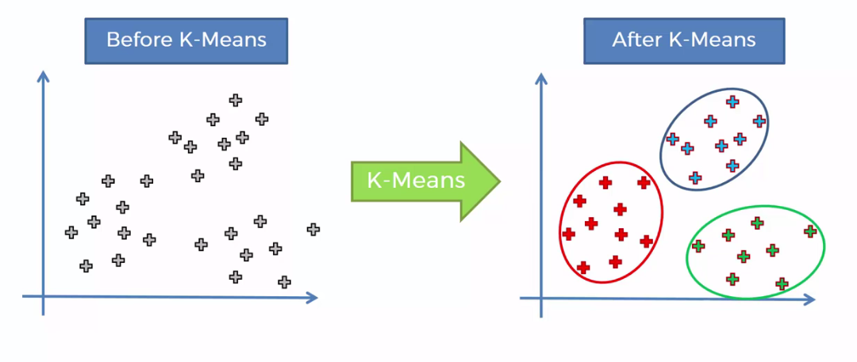
K-means clustering
Objective of clustering: group similar data points together and discover underlying patterns.
K-means looks for a fixed number (k) of clusters in a dataset

Slide 17
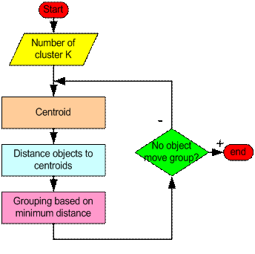
How the K-Mean Clustering algorithm works?

Slide 18
K-means clustering
Initialize and fit:
from sklearn.cluster import KMeans
kmeans = KMeans(n_clusters = 5, init = 'k-means++')
kmeans.fit(features)
Cluster assignments for each data point:
assignments = kmeans.fit_predict(features)
Centeroids:
kmeans.cluster_centers_

Slide 19
Thank you!

